Slide 1
KM Airlines -IAD Airport Turnover analysis
November, 2017

Slide 2


Current labor overview
Ground handling and cargo pay rates average below the first 15th percentile of the range for the station. Average pay rate across these stations is lower than the starting rate at many competitors.
Ramp
Headcount, 2017
Avg. FTE value
2017 avg. rate and range*
97%
1,233
~0.91
$12.07
$10.00
$23.37
Hourly
Salary
1,123 total FTE
Passenger Service
Headcount, 2017
Avg. FTE value
2017 avg. rate and range*
93%
105
~0.99
$13.63
104 total FTE
$11.00
$23.47
Hourly
Salary
Cleaning
Headcount, 2017
Avg. FTE value
2017 avg. rate and range*
83%
23
~1.0
$16.07
Hourly
Salary
23 total FTE
$14.00
$22.45
Notes: * indicates hourly employees only were considered for wage averages, wage ranges are min and max of active employees within each labor group

Slide 3

Employee paid utilization
Total paid outage tends to be relatively consistent throughout the year, with a peak in March; overtime cost has been trending up due to ongoing labor shortages.
Paid non-productive hours vs. Overtime (1.5/2.0) spend, 2017
Outage hours (K)
OT Spend USD (K)
Notes: 2017 OT spend includes OT 1.5 and 2.0; excludes unpaid time off.
Source: Swissport payroll Data

Slide 4


Swissport IAD Labor Trends
Since 2012, total headcount has grown by 217%; Swissport has hired 3,749 unique heads as 2,907 have left the company across all business units.
Headcount adjustments
Increase/decrease in count
+217%
524
Headcount net change
11
154
79
18
56
Note: 2017 includes hire and attrition data through September 18.
Source: Swissport payroll data

Slide 5
Swissport ground handling Labor Trends
Since 2012, total GH headcount has grown by 251%; Swissport has hired 3,426 unique heads as 2,567 have left the business unit.
Headcount adjustments
Increase/decrease in count
+251%
518
Headcount net change
21
592
67
38
57
Note: 2017 includes hire and attrition data through September 18.
Source: Swissport payroll data

Slide 6
Swissport Cargo labor trents
Since 2012, total Cargo headcount has grown by 62%; Swissport has hired 276 unique heads as 276 have left the business unit. Additional staffing has been obtained through transfers.
Headcount adjustments
Increase/decrease in count
+62%
Headcount net change
6
0
3
11
-18
-2
Note: 2017 includes hire and attrition data through September 18.
Source: Swissport payroll data

Slide 7
Swissport fueling labor trends
Since 2012, total fueling headcount has grown by 92%; Swissport has hired 47 unique heads as 64 have left the business unit. The remaining hires have been brought in through transfer from other lines of business.
Headcount adjustments
Increase/decrease in count
+92%
Headcount net change
1
0
-2
-4
-10
-2
Note: 2017 includes hire and attrition data through September 18.
Source: Swissport payroll data

Slide 8
Seniority distribution
Overall, ~34% of the active population has one year or less of seniority, whereas ~64% of the population tends to exit the company within the first year
Active employee distribution*
Business Unit | 3 months | 6 months | 9 months | 0.75-1 year | 1-2 years | 2-3 years | 3-4 years | 4-5 years | >5 years
Cargo
Fueling
Ground Handling
Station Total
Exited employee distribution*
Business Unit | 3 months | 6 months | 9 months | 0.75-1 year | 1-2 years | 2-3 years | 3-4 years | 4-5 years | >5 years
Cargo
Fueling
Ground Handling
Station Total
Notes: *) Active employees as of 9/2017, Exited employees include all instances from 2012 through 8/2017.
Source: Swissport payroll Data

Slide 9
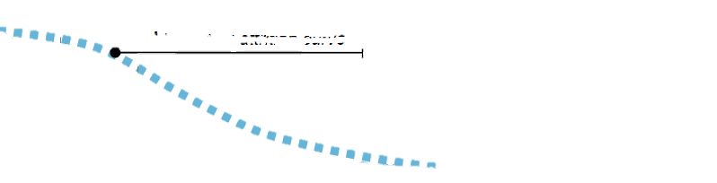
Swissport iad seniority Overview
The majority of exited employees tend to leave the company with about 3 months of service, whereas current active employees have a median seniority of 1.6 years. 1,119 employees exited the company prior to 30 days worked.
Active employee seniority*
Count of heads
Median: 1.6
Average: 2.8
Seniority
Exited employee distribution*
Count of heads
More ideal attrition curve
Increasing tenure will allow Swissport to reduce new hire training and shift funds to leadership and soft skills training
Median: 0.4
Average: 1.1
Seniority
Notes: *) Active employees as of 8/2017, Exited employees include all instances from 2012 through 8/2017
Source: Swissport payroll data

Slide 10
Cargo Seniority Overview
Cargo has a slightly higher retention rate than the total Swissport operation, with the median seniority of exited employees at 6 months.
Active employee seniority*
Count of heads
Median: 2.3
Average: 4.7
Seniority
Exited employee distribution*
Count of heads
Median: 0.5
Average: 1.3
Seniority
Notes: *) Active employees as of 8/2017, Exited employees include all instances from 2012 through 8/2017
Source: Swissport payroll data

Slide 11
Fueling Seniority Overview
Fueling is the smallest line of business at the station; median seniority for exited employees is the lowest at 0.7 years.
Active employee seniority*
Count of heads
Median: 1.8
Average: 4.5
Seniority
Exited employee distribution*
Count of heads
Median: 0.7
Average: 1.3
Seniority
Notes: *) Active employees as of 8/2017, Exited employees include all instances from 2012 through 8/2017
Source: Swissport payroll data

Slide 12
Ground handling Seniority Overview
Ground handling has the largest population among all business units, with most employees leaving within the first 5 months. Retention and tenure is significantly lower than the other two lines of business.
Active employee seniority*
Count of heads
Median: 1.6
Average: 2.6
Seniority
Exited employee distribution*
Count of heads
Median: 0.4
Average: 1.0
Seniority
Notes: *) Active employees as of 8/2017, Exited employees include all instances from 2012 through 8/2017
Source: Swissport payroll data

Slide 13
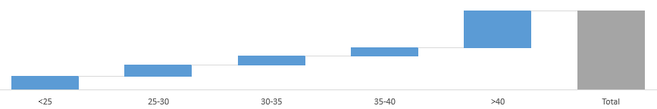
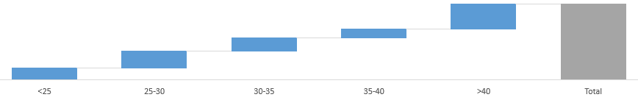
Age bucket distribution
31% of active employees are under the age of 30, whereas 38% of the exited population are under the age of 30.
Distribution of active heads by age*
% of heads
31%
47%
1,360
11%
11%
14%
17%
Distribution of exited heads by age*
% of heads
38%
33%
2,907
18%
12%
22%
16%
Notes: *) Active employees as of 8/2017, Exited employees include all instances from 2012 through 8/2017
Source: Swissport payroll data

Slide 14
IAD Employee DISTRIBUTION BY AGE AND SENIORITY
Employees 25 and younger have the lowest seniority when exiting the company with ~80% leaving within the first year, potentially indicating Swissport is looked as a job, not a career.
Active employee distribution*
Seniority Age | < 25 | 25 – 30 | 30 – 35 | 35 – 40 | > 40
< 1 year seniority
One to two years seniority
Two to three years seniority
Three to four years seniority
Four to five years seniority
> 5 years seniority
Exited employee distribution*
Seniority Age | < 25 | 25 – 30 | 30 – 35 | 35 – 40 | > 40
< 1 year seniority
One to two years seniority
Two to three years seniority
Three to four years seniority
Four to five years seniority
> 5 years seniority
Notes: *) Active employees as of 8/2017, Exited employees include all instances from 2012 through 2/2017
Source: Swissport payroll data

Slide 15
Ground handling Employee DISTRIBUTION BY AGE AND SENIORITY
Employees 25 and younger have the lowest seniority when exiting the company with ~80% leaving within the first year, potentially indicating Swissport is looked as a job, not a career.
Active employee distribution*
Seniority Age | < 25 | 25 – 30 | 30 – 35 | 35 – 40 | > 40
< 1 year seniority
One to two years seniority
Two to three years seniority
Three to four years seniority
Four to five years seniority
> 5 years seniority
Exited employee distribution*
Seniority Age | < 25 | 25 – 30 | 30 – 35 | 35 – 40 | > 40
< 1 year seniority
One to two years seniority
Two to three years seniority
Three to four years seniority
Four to five years seniority
> 5 years seniority
Notes: *) Active employees as of 8/2017, Exited employees include all instances from 2012 through 2/2017
Source: Swissport payroll data

Slide 16
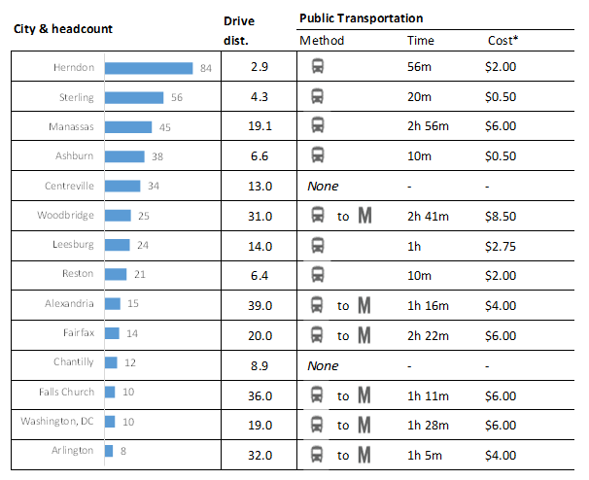
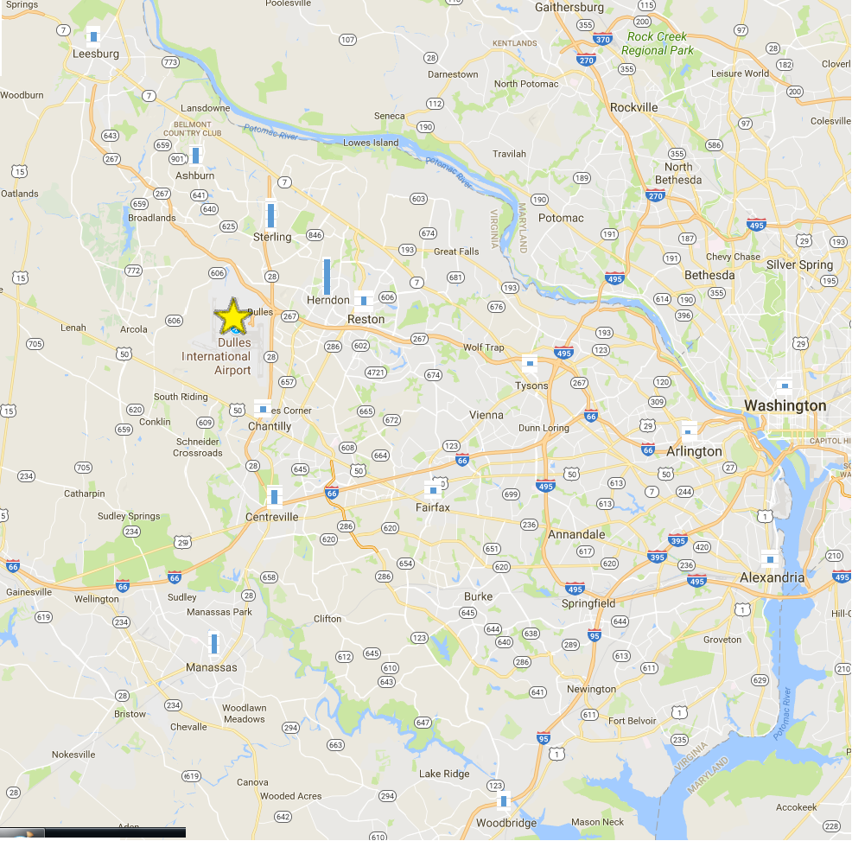
Exited employee geography
Drive distance from the most common location is an average of 12.8 miles each way; average commute time is 65 minutes each way.
Exited employee location
Notes: *Average cost is a one-way fare; miles to IAD is the distance from the zip code to IAD per the fastest route as provided by Google Maps; Transportation methodology, time, and costs are provided by Google Maps and are as of September 16, 2017.

Slide 17
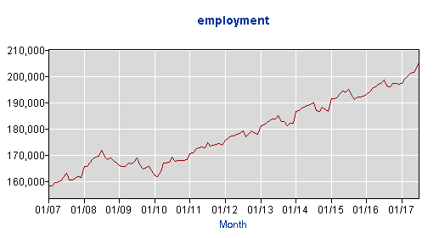
Labor market overview
Loudoun County has had steady growth in employment, which has driven unemployment to a low 3.2%; cost of employment and living is significantly higher than the national average.
Loudoun County Employment Rate
High-level national wage comparison*
Cost of living comparison
Occupation | Mean hourly wage
 | National | Metro Area | Vari.
All Occupations | $23.23 | $33.12 | 43%
Transportation | $16.90 | $20.06 | 19%
Food Prep and Serving | $10.98 | $12.88 | 17%
Production | $17.41 | $19.88 | 14%
Category | Median Expense
 | National | Metro Area | Vari.
1 bedroom rent** | $1,230 | $2,271 | 85%
1 gallon milk* | $3.17 | $3.73 | 18%
1 dozen eggs* | $1.33 | $3.40 | 159%
1 gallon gas^ | $2.30 | $2.53 | 10%
Notes: *) Rates as of June 2017, provided by BLS
Source: **) GoBankingRates national survey; ^) SmartAsset survey;

Slide 18
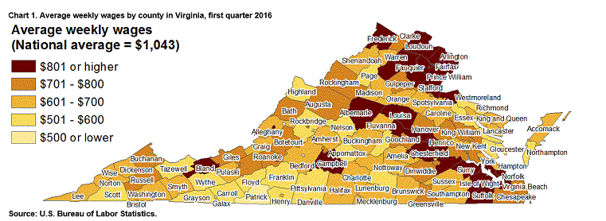
Wage environment overview
Virginia and the federal government have set a legal minimum wage - Virginia's is $7.25 per hour, while the federal minimum wage is $7.25 per hour. The legal requirements do not come close to the local cost of wages for skilled and unskilled labor in the surrounding area.
Employment increases in Loudoun county ranked third highest in nation. Loudoun has the fastest rate of employment growth in the state, at 6.2% currently.

Slide 19






LOCAL IAD Available jobs
Swissport is competing against certain employers who offer higher initial pay, many are coupled with an easier workload and indoor work environment
Company | Position | Starting rate $ | Bonus | Location | Heavy Lifting
Swissport | Ramp Svc. | $11.00
Walmart | Sales Assoc. | $13.00
G2 Security | Security Agent | $12.00
TSA | Transportation Security Agent | $17.00
ABM Aviation | Floor tech | $13.00
Super Shuttle | Cust. Svc. | $13.00
While there are other openings that pay at or below Swissport’s starting level, there are also many others that offer a higher starting rate, driving a gap greater than $1
Source: Weblinks available on last page.

Slide 20
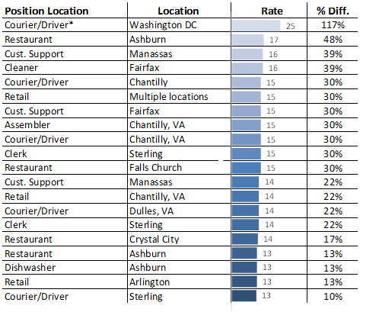
LOCAL open POSITIONS
There are many positions within the area that offer, on average, wages that are more than $2/hour greater; some with competitive benefit offerings.
Local position comments
The average starting rate for this selection of positions is $15.00 per hour
This average rate is ~$3.50 higher than Swissport (30% variance)
Many positions offer higher rates depending on experience or workload, which further drives the average pay rate up compared to the starting rate of working at Swissport.
Many of these positions also offer full benefits, 401(k), and other competitive offerings, in a less demanding environment.
Notes: *) indicates a contract based employer
Source: Craigslist available jobs as of September 18, 2017

Slide 21
Washington dc Metro bls data
The 25th percentile wage is on average 26% higher than the MWAA upcoming minimum wage ($11.55/hr). The gap in wages becomes even more significant when comparing to the median of the pay ranges for similar jobs, with average wages being 61% higher.
Position | 25% | Median | % Diff.
Construction |  |  | 45%
Security |  |  | 24%
Cust. Svc. |  |  | 19%
Receptionists |  |  | 3%
Mx/Repair |  |  | 43%
Groundskeeping |  |  | 3%
Carpenters |  |  | 64%
Counter Clerks |  |  | -6%
Shipping Clerks |  |  | 21%
Cooks |  |  | 15%
Production Clerks |  |  | 72%
Ticket Agents |  |  | 13%
Data Entry |  |  | 15%
Transportation Screeners |  |  | 65%
Pest Control Workers |  |  | 33%
Order Clerks |  |  | 10%
Couriers |  |  | 4%
Paving Equip Operators |  |  | 28%
Transportation Attendants |  |  | 58%
Machine Feeders |  |  | 7%
Vending Machine Servicers |  |  | 12%
Material Handlers |  |  | 25%
Local position comments
The average 25th percentile rate for potential alternative positions is $14.50 per hour
This average rate is $3 higher than Swissport (26% variance)
The median, which can be compared to Swissport’s static rate, is $18.56 per hour
This average rate is ~$7 higher than Swissport (61% variance), if the Swissport rate is at $11.55
If the Swissport rate is $12.60, the average rate of the alternative jobs is $5.96 higher (47% variance)
BLS data does not account for impacts to wages driven by competition or limited workforce availability
Wages, as shown, would likely see an increase if data was as of 2017
Notes: Rates are as of 2016; does not account for general wage increases related to competition and constrained workforce.
Source: United States BLS Washington DC Metro labor data https://www.bls.gov/oes/current/oes_47894.htm

Slide 22
Average wage summary
Swissport starting wages are lower than the 25th percentile wages seen in the Washington DC Metro area; compared to the average of the other observed wages, there is a 42% gap.
Average wage overview
USD
+62%
Variance | +$4.88 | +$2.18 | +$3.50 | +$8.66 | +$3.00 | +$7.06
Note: Averages and rates shown are reflective of positions and wages at the time of the analysis, are subject to change, and do not necessarily represent the total open jobs market.

Slide 23
High-level cost overview
Overall cost to take wages to market rates would be partially offset by decreased overtime costs. A tenure-based wage progression will assist with retention and reduce turnover and training costs.
New Hourly Wage Rates: Proposed
Length of Service | United Express | General Ramp | Cargo
Date of hire | $12.10 | $12.60 | $12.10
90 days | $12.35 | $12.85 | $12.35
6 months | $12.60 | $13.10 | $12.60
1 year | $13.00 | $13.50 | $13.00
2 years | $13.50 | $14.00 | $13.50
3 years | $14.00 | $14.50 | $14.00
Estimated annual wage impact to implement the above salary structure would increase annual wage costs by $2.3 million. Estimated overtime reduction will help offset these costs by roughly $1.7 million annually.
Source: Swissport payroll data

Slide 24





Overview of handling attrition
While the cost implication of increased wages may be offset by reducing training expenses, Swissport will realize additional benefit from improving retention and increasing attraction
Improving attrition and attraction requires a comprehensive approach
Attracting an employee
Competitive entry hourly wage
Primary benefits (health, vacation, etc.)
Secondary benefits (parking, trans., meals)
Keeping an employee
Strong supervisor leadership
Investments in employee training
Culture that motivates growth & rewards performance
Even with improvements to wages, those that want to leave will leave
Initially, attrition may not be immediately improved; this will be heavily influenced by culture
Improving the culture via enhanced training for supervisors will have a lagging, but beneficial impact
Once the changes take effect, the benefit will be greater than savings driven by reduced training
Enhanced culture, motivating employees and fostering dedication
Improved employee predictability and scheduling
Enhanced Service to customers, protecting revenue sources
Reduced safety incidents and equipment damages

Slide 25



Example graphic: demonstrating swissport total comp (GROUND HANDLING)
What is my total compensation at Swissport?
It is more than just your hourly wage.
Additional Benefits:
Employer Paid Parking
401(k) with Employer match
Company Paid Life Insurance
PTO Accrual (40 Hours)- Begins Year One
Paid Holidays and Bereavement Pay
Parking
.60 increase after 6 months of emp.
Market competitive wages
Covered health insurance
Retention Increase
All additional benefits
+ $26,208*
+ $1,274
+ $624
+ $2,790
Potential total compensation
+ $
$14.85
$ per hour

Slide 26
Example graphic: demonstrating swissport total comp (Cargo)
What is my total compensation at Swissport?
It is more than just your hourly wage.
Additional Benefits:
Employer Paid Parking
401(k) with Employer match
Company Paid Life Insurance
PTO Accrual (40 Hours)- Begins Year One
Paid Holidays and Bereavement Pay
Parking
.60 increase after 6 months of emp.
Market competitive wages
Covered health insurance
Retention Increase
All additional benefits
+ $25,168*
+ $1,274
+ $624
+ $3,286
Potential total compensation
+ $
$14.59
$ per hour

Slide 27
Example graphic: demonstrating swissport total comp (Fueling)
What is my total compensation at Swissport?
It is more than just your hourly wage.
Additional Benefits:
Employer Paid Parking
401(k) with Employer match
Company Paid Life Insurance
PTO Accrual (40 Hours)- Begins Year One
Paid Holidays and Bereavement Pay
Parking
.60 increase after 6 months of emp.
Market competitive wages
Covered health insurance
Retention Increase
All additional benefits
+ $29,120*
+ $1,274
+ $624
+ $3,831
Potential total compensation
+ $
$16.75
$ per hour

